Slide 1
HISTORICAL ECOLOGY OF CORAL REEFS in Encyclopedia of Modern Coral Reefs pp. 554 John M. Pandolf
Slides: S. Ikari
2022/07/19

Slide 2
Human impacts on coral reefs
Increased impacts:
Overfishing
Pollution
Agriculture
Land development
…

Slide 3
Human impacts on coral reefs
Increased impacts:
Overfishing
Pollution
Agriculture
Land development
…
Fragmentation of coral reef habitats
Undermined resilience

Slide 4
Human impacts on coral reefs
Increased impacts:
Overfishing
Pollution
Agriculture
Land development
…
Fragmentation of coral reef habitats
Undermined resilience
Modern coral reefs might be much more susceptible to current and future climate-change than is suggested by their geologic history.

Slide 5
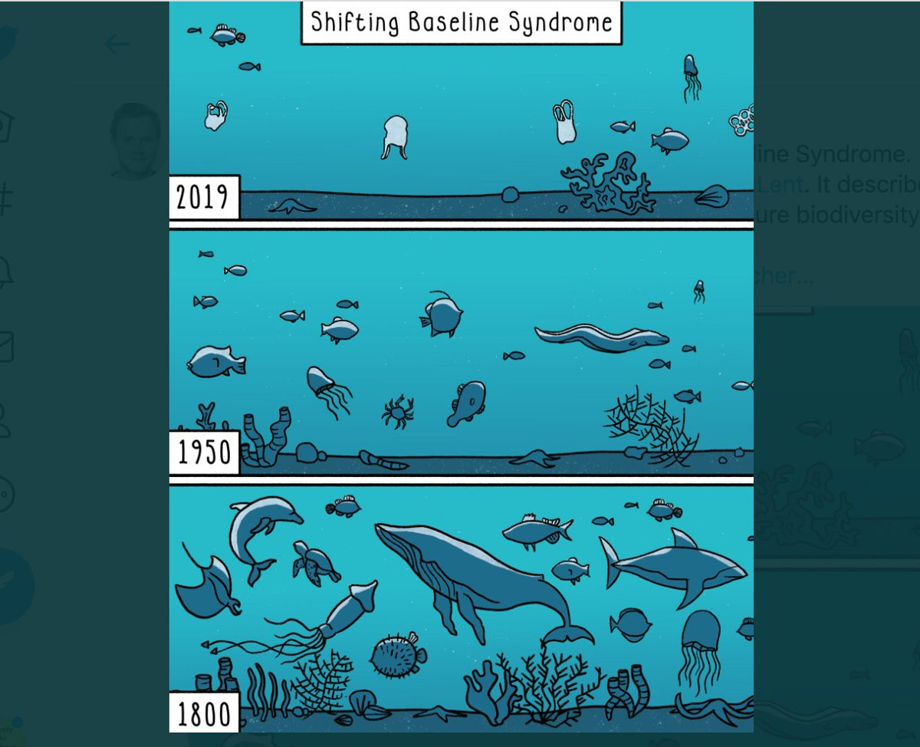
What was natural in the world before humans impacted it?
“shifting baseline syndrome” (Pauly, 1995)
Research on past ecosystem health / human-ecological interaction
provides what was “natural” in the sea.

Slide 6
Historical ecology
Links past ecosystem condition with the present state
Multiple time scales (decades to millennia)
Examines changes in
states of populations, species, and ecosystems
(e.g., abundance, biomass, geographic ranges)
environmental parameters
(e.g., sea surface temperature fluctuations)
magnitudes and rates of both biological processes
(e.g., mortality rates, trophic flows, disturbance regimes)
and physical processes.
(e.g., El Nino-Southern Oscillation, climate change)

Slide 7
The tools of marine historical ecology
Objective:
Natural baseline for community ecology and coral growth rates
Combination of multiple data
Archaeological sites: civilization-ecosystem interaction
ships logs, publications of early naturalists and European colonialists: the natural history and inferred ecology of many coral reef inhabitants
Fisheries records and modern ecological surveys (+ remote sensing data): interaction between increased human population and ecosystem function

Slide 8
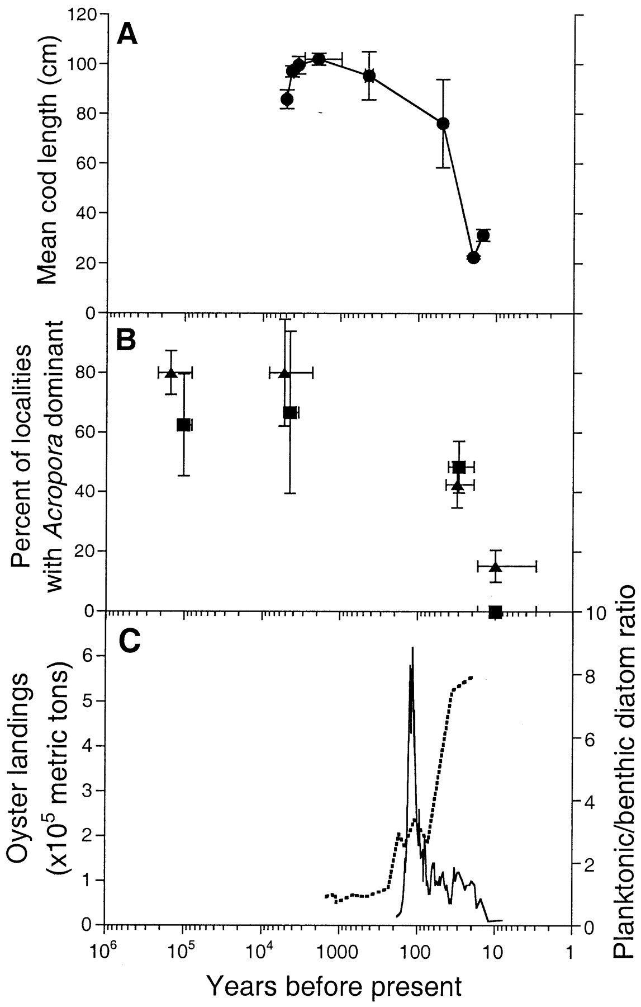
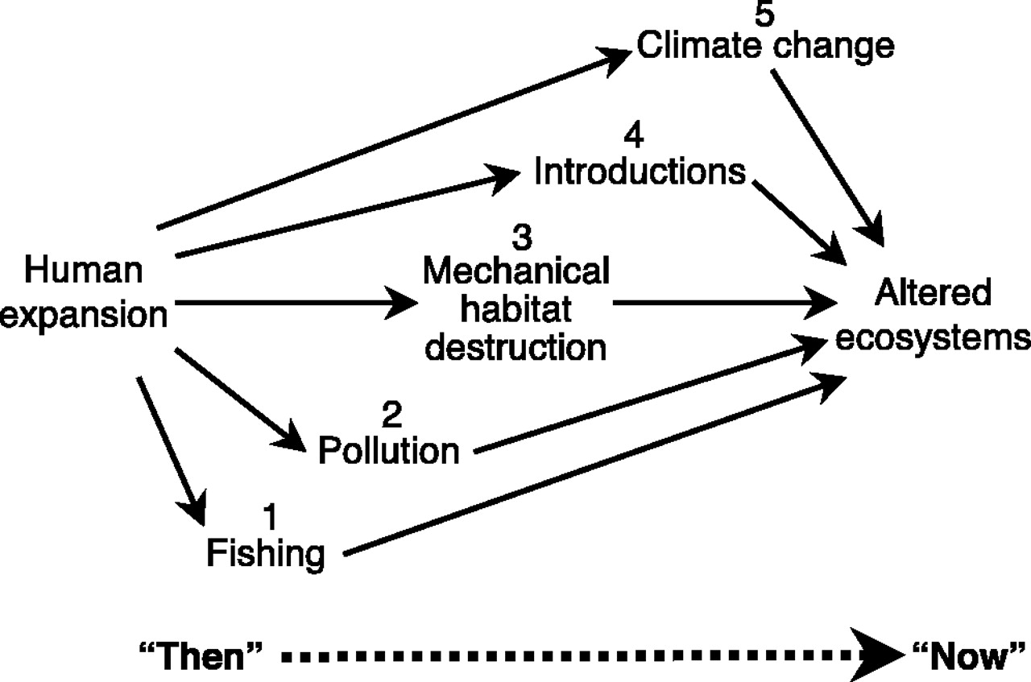
Jackson, J. B., Kirby, M. X., Berger, W. H., Bjorndal, K. A., Botsford, L. W., Bourque, B. J., ... & Warner, R. R. (2001). Historical overfishing and the recent collapse of coastal ecosystems. science, 293(5530), 629-637.
大西洋のタラの体サイズ
@メイン湾
Acropora優占サイト率
＠カリブ海
カキ固着（実線）
プランクトン/ベントス比
（点線）富栄養化の指標
＠チェサピーク湾

Slide 9
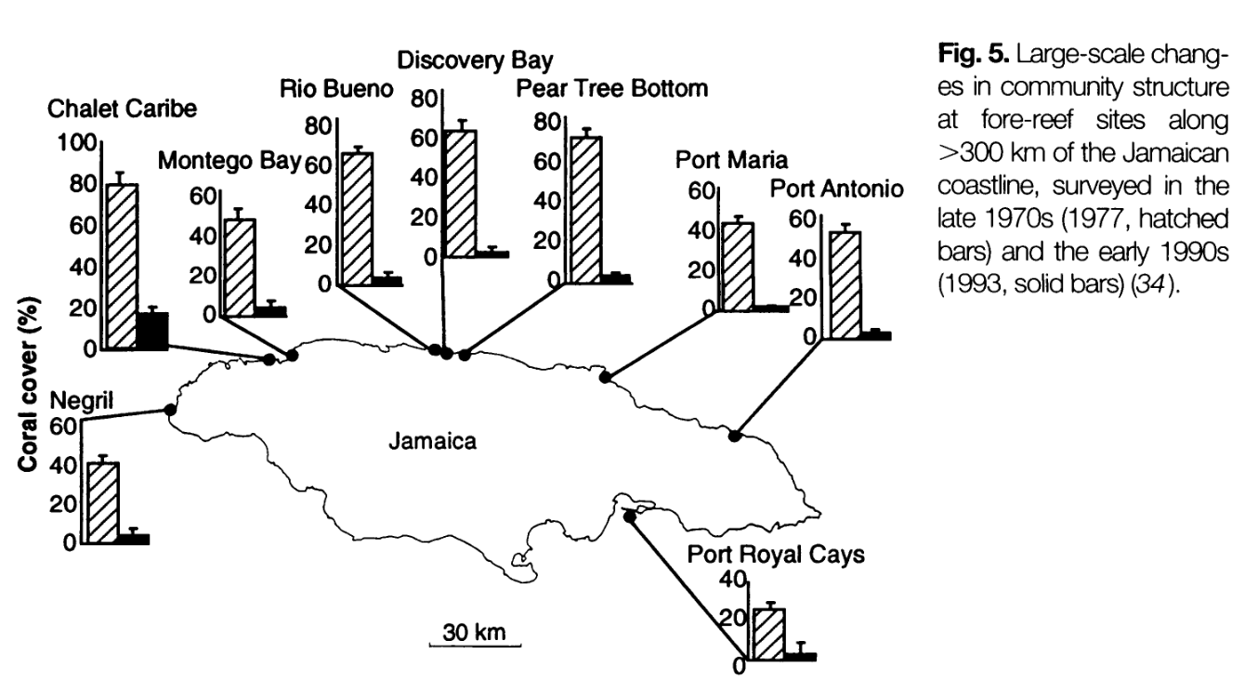
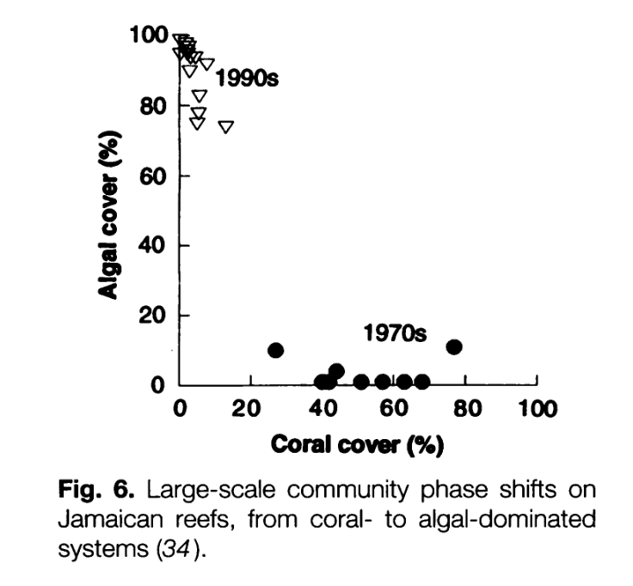
The global decline of coral reefs since the arrival of humans
Hughes, T. P. (1994). Catastrophes, phase shifts, and large-scale degradation of a Caribbean coral reef. Science, 265(5178), 1547-1551.

Slide 10
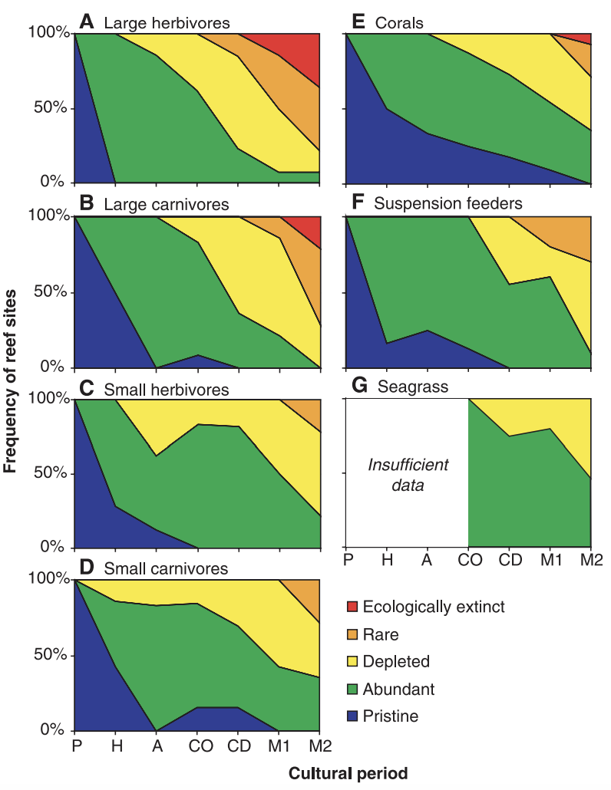
The global decline of coral reefs since the arrival of humans
Pandolfi, J. M., Bradbury, R. H., Sala, E., Hughes, T. P., Bjorndal, K. A., Cooke, R. G., ... & Jackson, J. B. (2003). Global trajectories of the long-term decline of coral reef ecosystems. Science, 301(5635), 955-958.
P, prehuman
H, hunter-gatherer
A, agricultural
CO, colonial occupation
CD, colonial development
M1, early modern (distance no object)
M2, late modern to present (globalization)

Slide 11
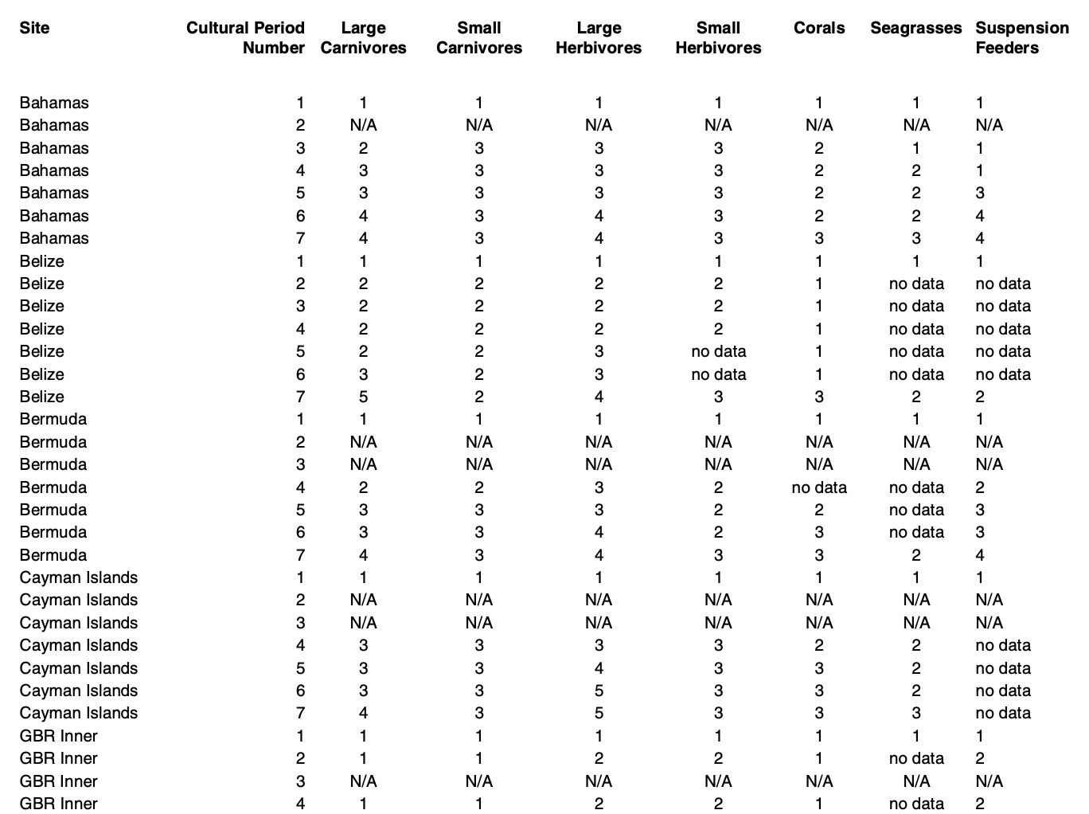
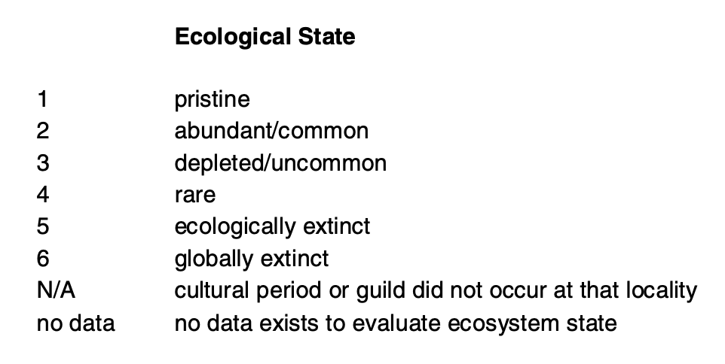
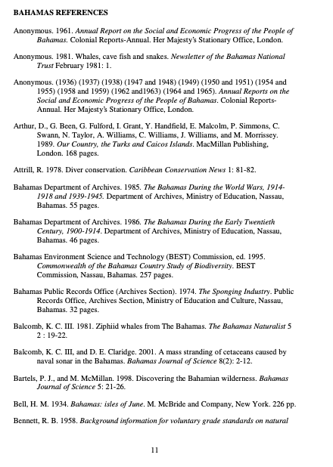
The global decline of coral reefs since the arrival of humans
Pandolfi, J. M., Bradbury, R. H., Sala, E., Hughes, T. P., Bjorndal, K. A., Cooke, R. G., ... & Jackson, J. B. (2003). Global trajectories of the long-term decline of coral reef ecosystems. Science, 301(5635), 955-958.
P, prehuman
H, hunter-gatherer
A, agricultural
CO, colonial occupation
CD, colonial development
M1, early modern (distance no object)
M2, late modern to present (globalization)

Slide 12
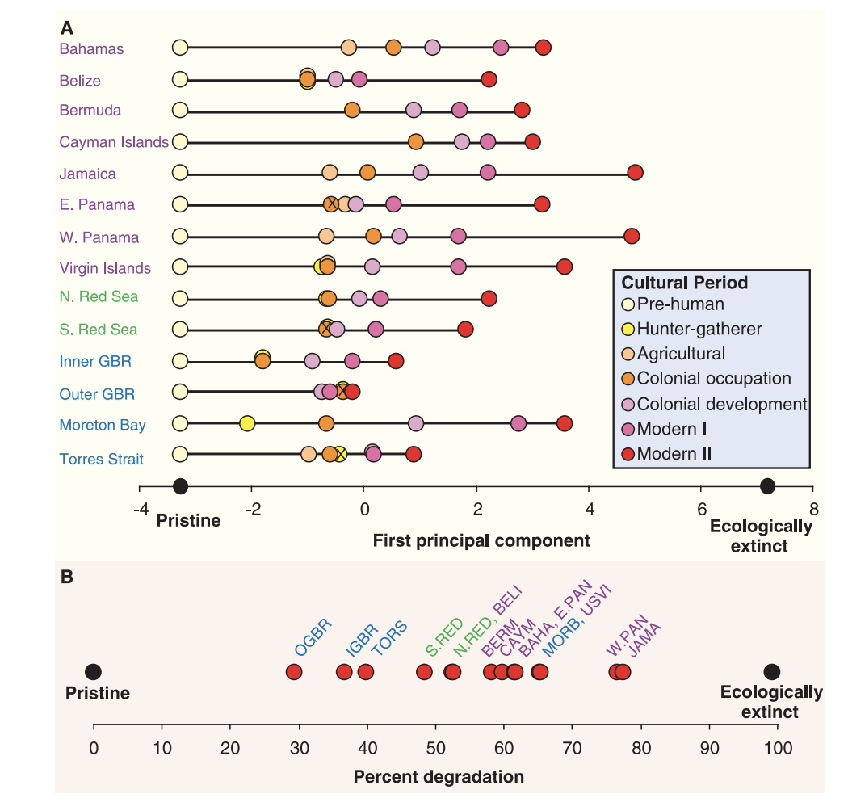
The global decline of coral reefs since the arrival of humans
Pandolfi, J. M., Bradbury, R. H., Sala, E., Hughes, T. P., Bjorndal, K. A., Cooke, R. G., ... & Jackson, J. B. (2003). Global trajectories of the long-term decline of coral reef ecosystems. Science, 301(5635), 955-958.
P, prehuman
H, hunter-gatherer
A, agricultural
CO, colonial occupation
CD, colonial development
M1, early modern (distance no object)
M2, late modern to present (globalization)
PCA

Slide 13
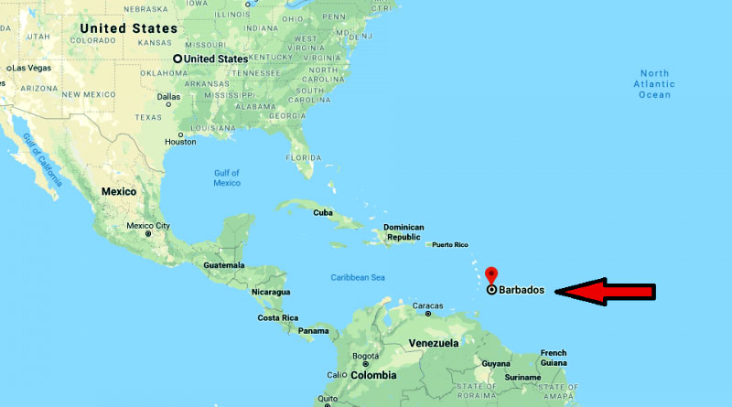
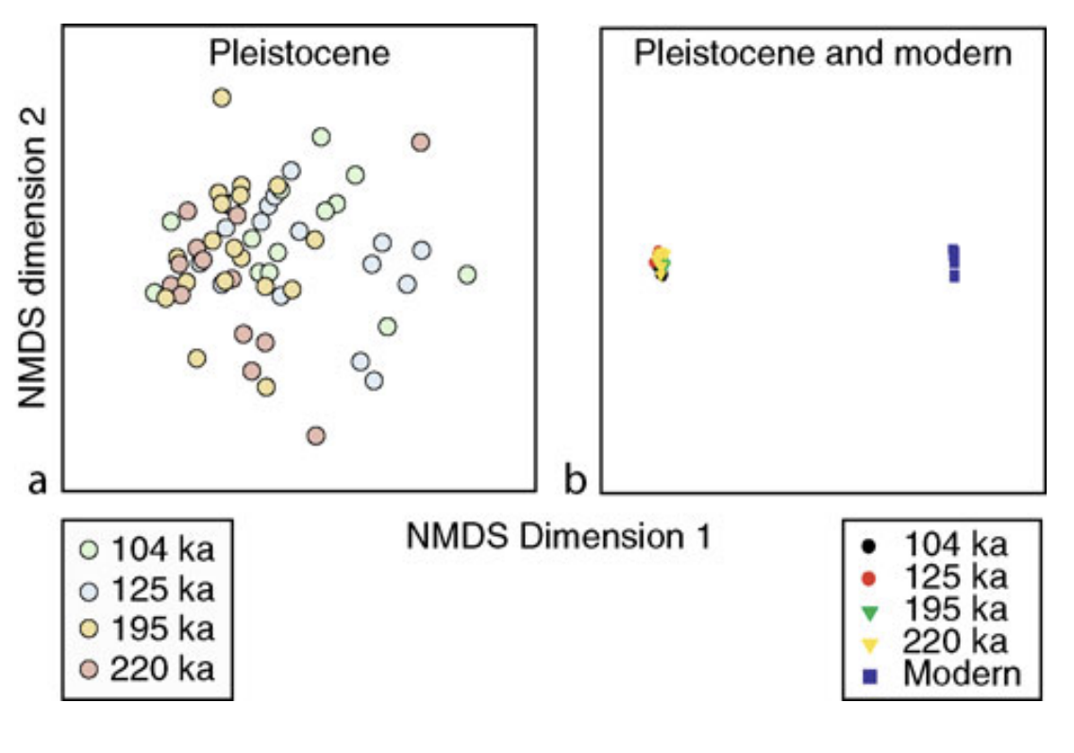
Historical Ecology of Coral Reefs: Pleistocene to modern
Jackson and Pandolfi, 2006
Age | Delta °C* | CO₂ (ppmv)
Mid-1980s | 0 | 350.0
104 ka | −4.16 | 230.9
125 ka | 0.24 | 276.5
195 ka | −5.22 | 231.5
220 ka | −4.31 | 251.2
Notes:
Acropola Palmataは1%以下になってしまった
http://bajapanese.blog.fc2.com/?no=36
1600年ごろにオランダ人がブラジルからバルバドスにさとうきびを持ち込み、 それ依頼バルバドスの主要の産業になっているようです

Slide 14
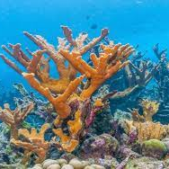
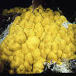
Historical Ecology of Coral Reefs: Pleistocene to modern
Jackson and Pandolfi, 2006
Age | Delta °C* | CO₂ (ppmv)
Mid-1980s | 0 | 350.0
104 ka | −4.16 | 230.9
125 ka | 0.24 | 276.5
195 ka | −5.22 | 231.5
220 ka | −4.31 | 251.2
Acropora palmata
Acropora cervicornis
Porites astreoides
Porites porites
Notes:
Acropola Palmataは1%以下になってしまった
http://bajapanese.blog.fc2.com/?no=36
1600年ごろにオランダ人がブラジルからバルバドスにさとうきびを持ち込み、 それ依頼バルバドスの主要の産業になっているようです

Slide 15
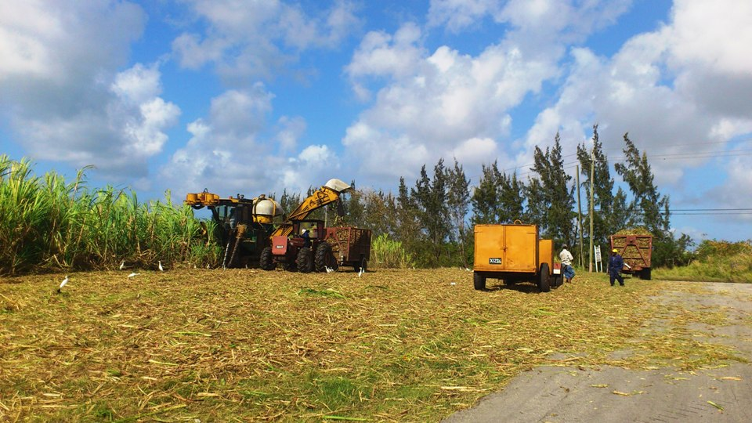
Historical Ecology of Coral Reefs: Pleistocene to modern
Jackson and Pandolfi, 2006
Age | Delta °C* | CO₂ (ppmv)
Mid-1980s | 0 | 350.0
104 ka | −4.16 | 230.9
125 ka | 0.24 | 276.5
195 ka | −5.22 | 231.5
220 ka | −4.31 | 251.2
Persistence of community in Pleistocene
Modern variability caused by overfishing, disease, land erosion
Sugar cane agriculture in the mid-17th century had severe impact on the marine ecosystem.
Acropora palmata
Acropora cervicornis
Porites astreoides
Porites porites
Notes:
Acropola Palmataは1%以下になってしまった
http://bajapanese.blog.fc2.com/?no=36
1600年ごろにオランダ人がブラジルからバルバドスにさとうきびを持ち込み、 それ以来バルバドスの主要の産業になっているようです
キクメイシは環境変動につよい？

Slide 16
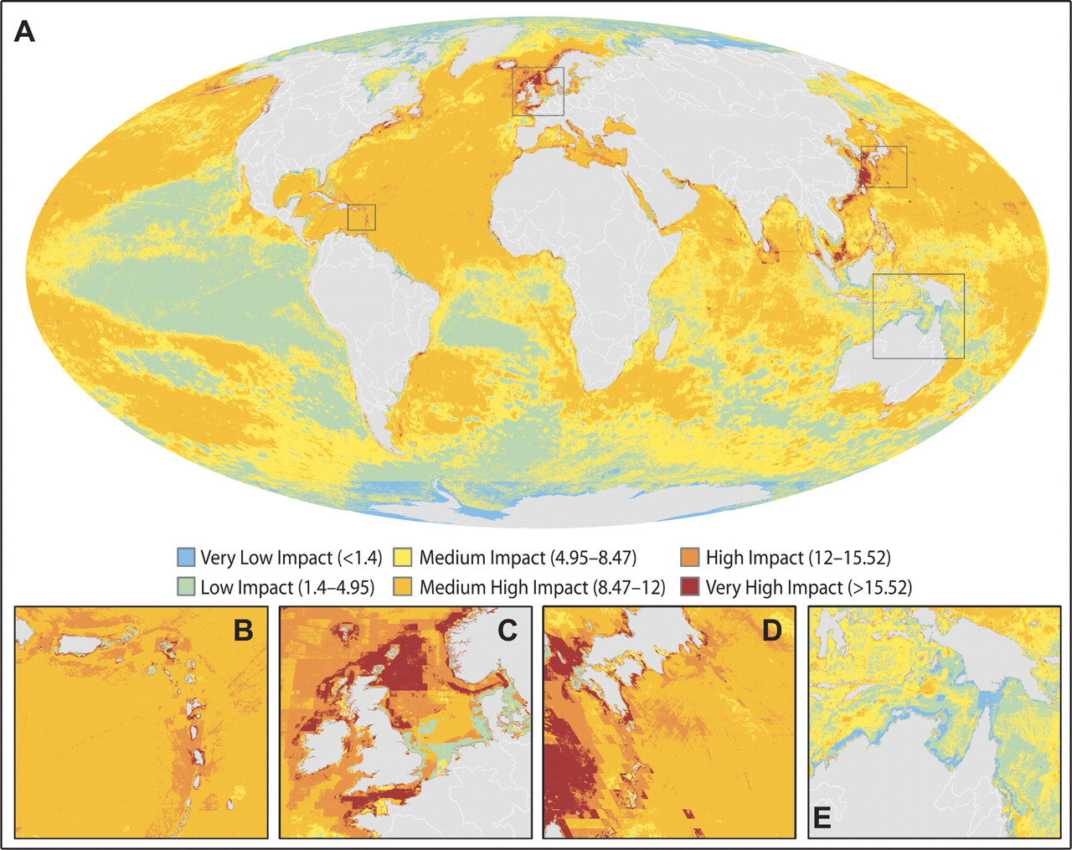
A GLOBAL MAP OF HUMAN IMPACT ON MARINE ECOSYSTEMS

Slide 17
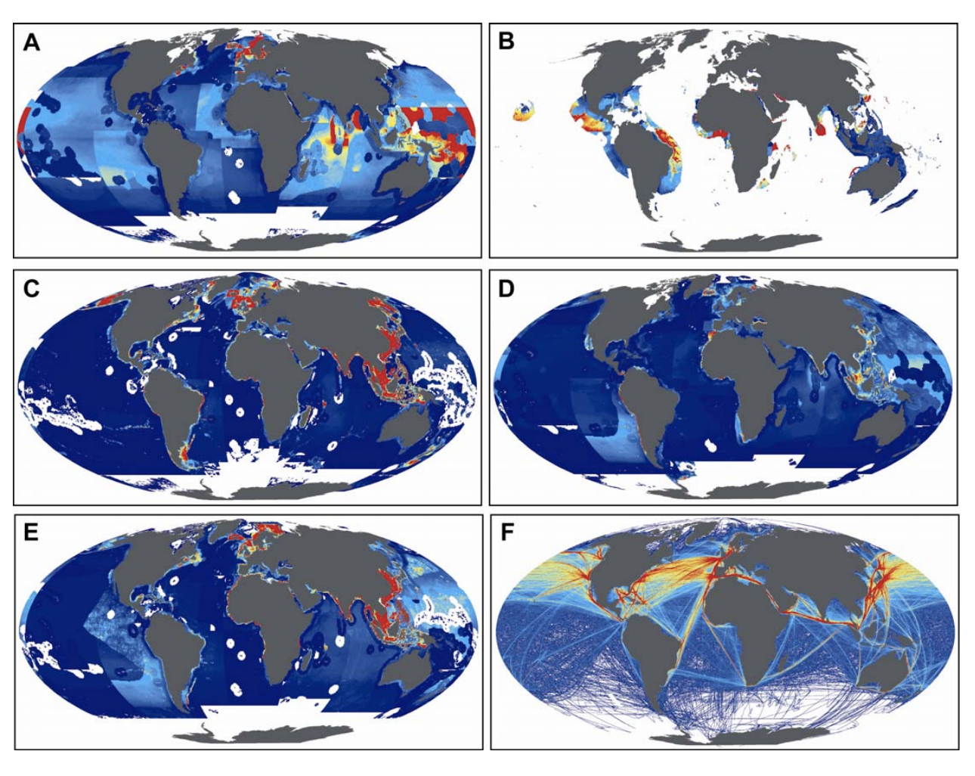
A GLOBAL MAP OF HUMAN IMPACT ON MARINE ECOSYSTEMS
Compiling expert knowledge
Example layers
A) pelagic, low-bycatch fishing,
B) pelagic, high-bycatch fishing,
C) demersal habitat-modifying fishing,
D) demersal non-habitatmodifying, low-bycatch fishing,
E) demersal non- habitat-modifying, high-bycatch fishing,
F) shipping,
Notes:
Global maps of each driver layer (or regional maps, when not visible at global scale) used in analyses: A) pelagic, low-bycatch fishing, B) pelagic, high-bycatch fishing, C) demersal habitat-modifying fishing, D) demersal non-habitatmodifying, low-bycatch fishing, E) demersal non- habitat-modifying, high-bycatch fishing, F) shipping,

Slide 18
Implications for management
Problems
management without a temporal context
a diminished ability to differentiate between chronic and cumulative impacts
uncertainty in attributing ecological changes to human or natural agency
encouraged equilibrium views of ecosystem dynamics
difficulty in setting management goals and assessing the effectiveness of management actions.
Solution
identifying drivers of ecosystem change
providing meaningful goals for successful management and a means for measuring success of management actions
adopting a dynamic view of ecosystems.

